Slide 1
Case-Study
18BCS6189
M Thanuj Reddy
AIM: Predict cancer mortality rates for US counties.

Slide 2
Problem Solving Methodology
Data Loading
Cleaning data
Function Definitions for Plotting.
Correction of Data And Visualizing the data.
Building the model.
Residual Analysis of the train data.
Model Evaluation.
RESULTS

Slide 3
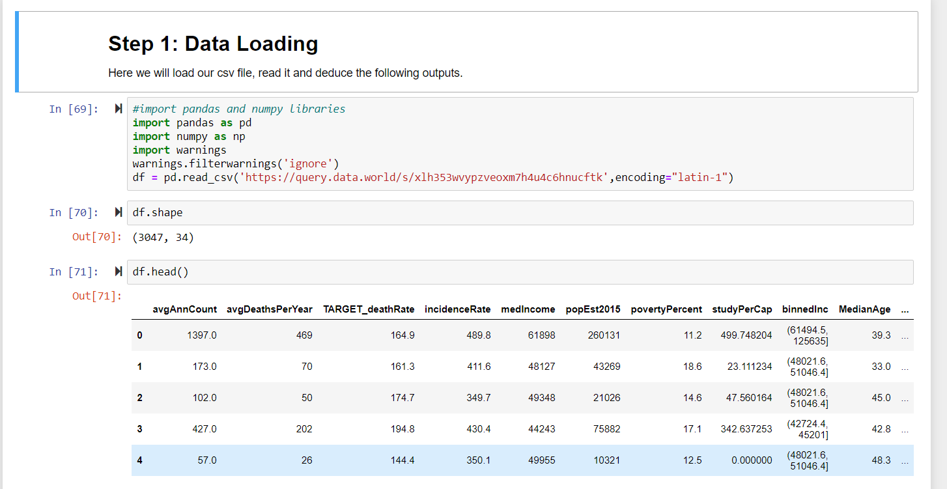
Data Loading *As we load the data from csv file

Slide 4
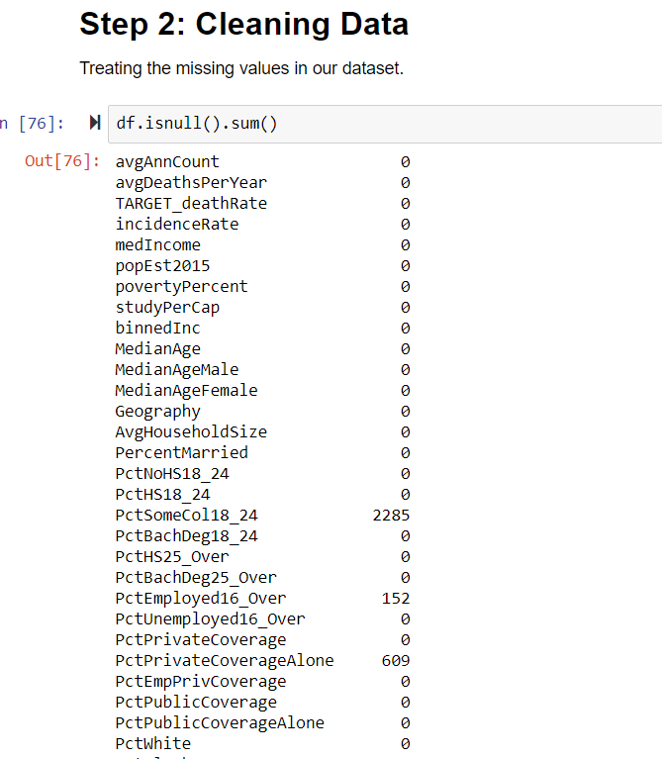
Cleaning Data
Using isnull (return boolean value)
And isnull().sum()(return count of null value in data)

Slide 5
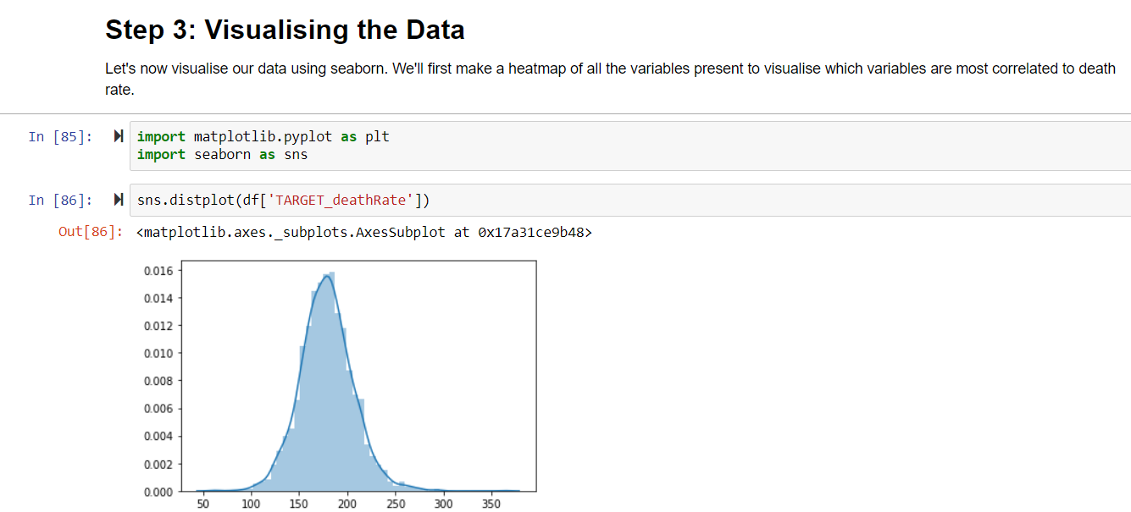
Visualizing the data
Let's now visualize our data using seaborn. We'll first make a heatmap of all the variables present to visualize which variables are most correlated to death rate.

Slide 6
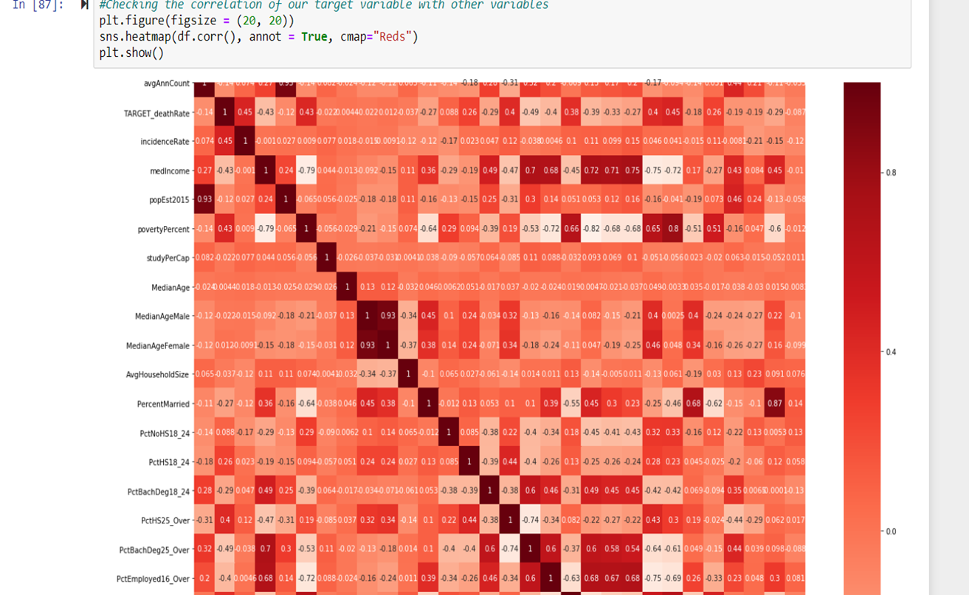
Checking the target variable with other variable

Slide 7
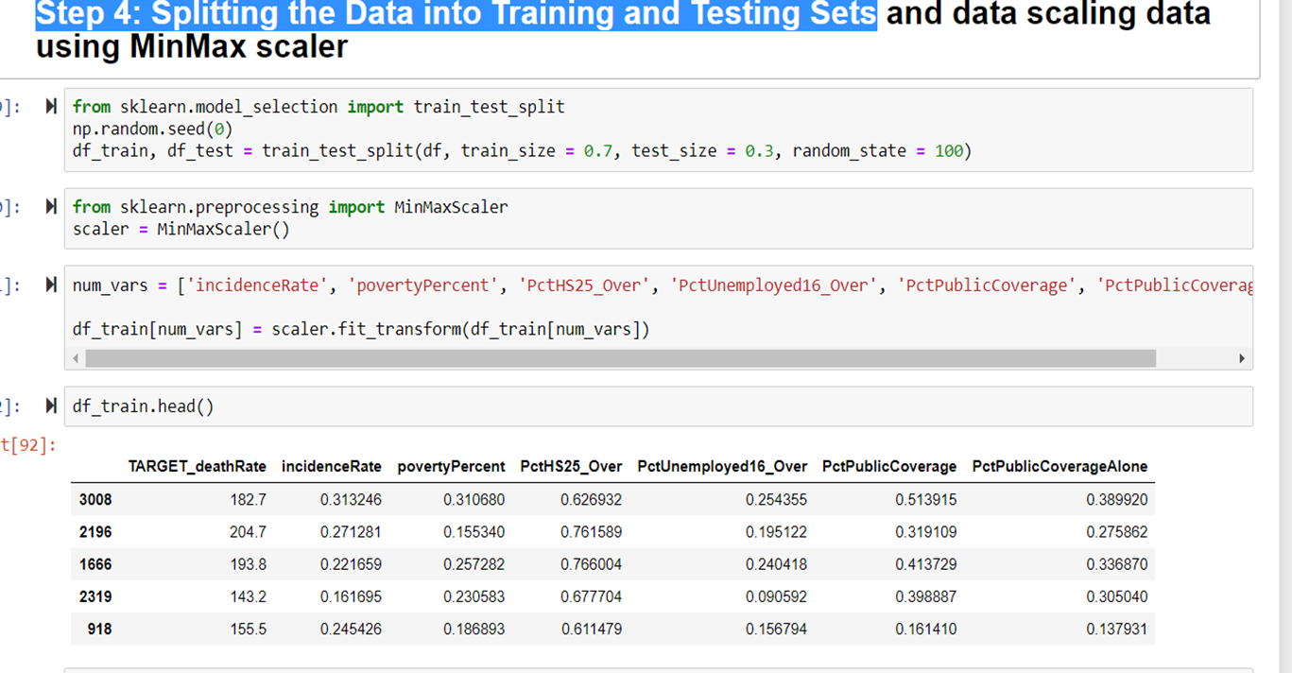
Splitting the data into training and testing dataset

Slide 8
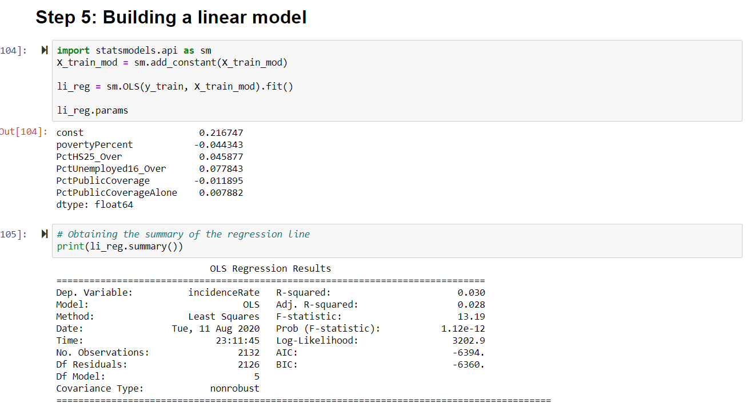
Building A LINEAR MODEL

Slide 9
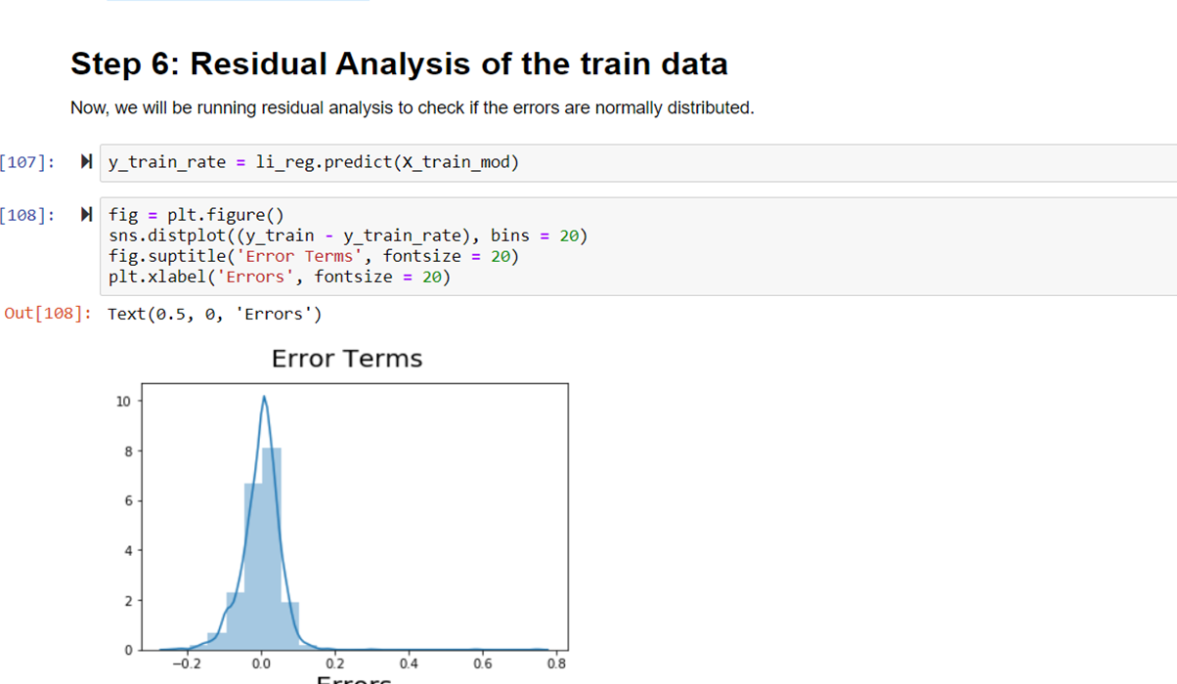
Residual Analysis of the train data

Slide 10
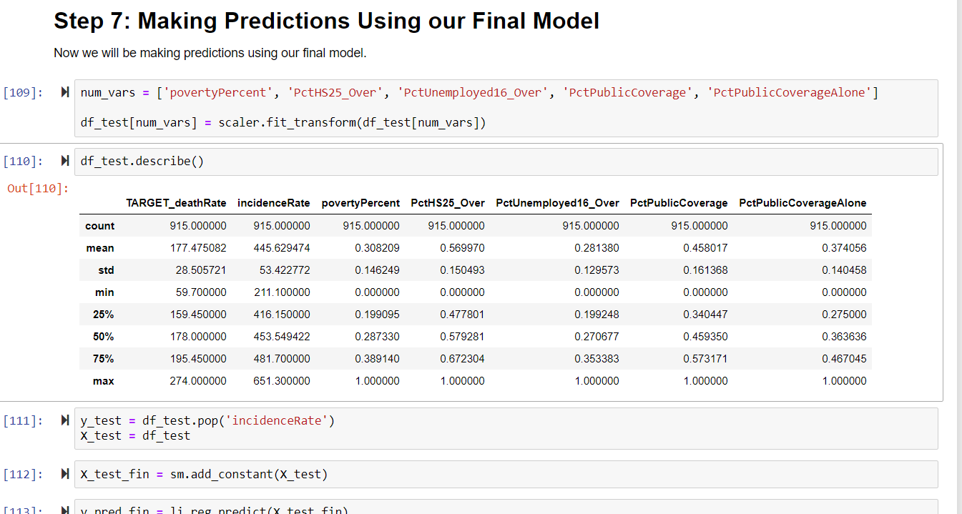
Making Prediction Using our Final Model

Slide 11
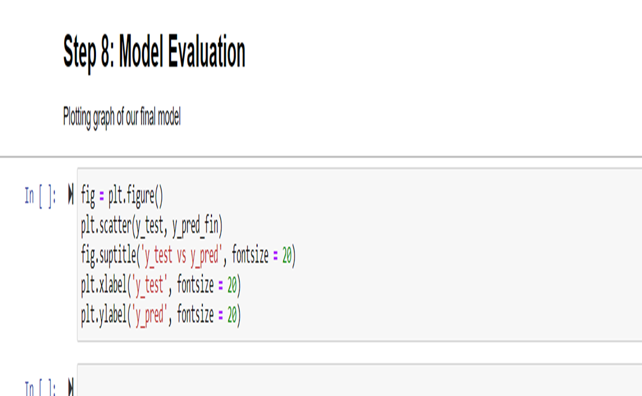
Model Evaluation

Slide 12
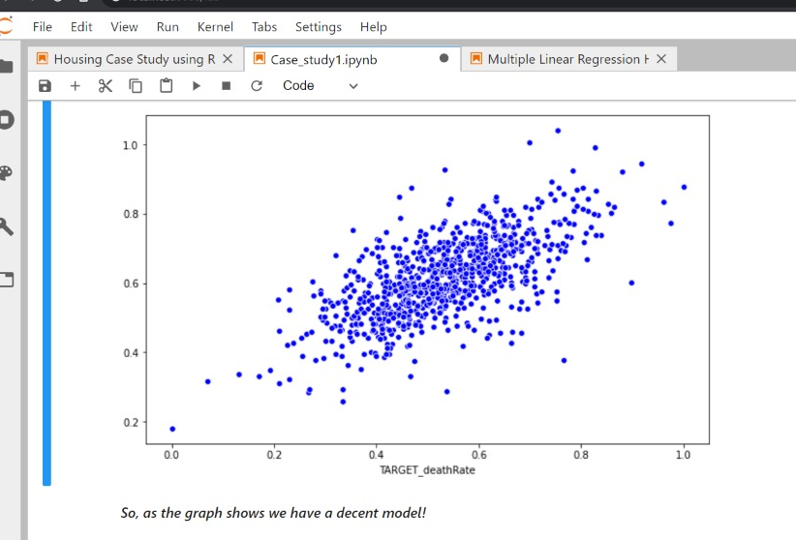
Results

